Slide 1


D I G I T A L L I B R A Y &
P A P E R L E S S L E A R N I N G
R E S O U R C E M A N A G E M E N T S Y S T E M
GOWTHAM S 1971260007
SIDHARDHA V 1965260034
GOKUL K 1911260026
GOWTHAM
1971260007
Course name : Object Oriented Programming concepts in C++
Course code : DSA0101
Guided by : Dr. K. PARIMALA KANAGA DEVAN

Slide 2

Introduction
Modern Academic Need
Higher education institutions are
transitioning rapidly from physical print media to digitized learning assets. Managing digital books, e-journals, lecture media, and research repositories requires systematic access control and streamlined digital indexing.
Paperless Ecosystem
Apaperless learning resourcesystem
eliminates manual paperwork, physical ledger logging, and lost book entries. It facilitates instant digital checkouts, continuous availability monitoring, and eco-friendly institutional resource administration.

Slide 3


I M A T S
Literoture Sumey (2024-2025)
E NGI NE ERING
Recent innovations, gaps identlied, and our proposed augmentations.
Author | Year | Method | Pros / Cons | Our SOlLltİOfl
Lee | 2025 | Oline-first reader app | Pros: accessibil•cy. Cons: sync conflicts | Conflict-resilient sync whh versioning
Nguyen & Silva | 2025 | Open-access analyics | Pros: transparency. Cons: privacy | Privacy-preserving aggregated analyics
 |  |  | concerns
Kumar et al. | 2024 | Al-based content tagging | Pros: faster indexing. Cons: bias in models | HUlzlan-in-loop V Ïdation + falrness checks

Slide 4




System Objectives
Automate Operations
Develop a software core
to handle book issuance, return tracking, member authentication, and catalog searches seamlessly.
Digital Cataloging
Implement structured
data models for digital resources including eBooks, journal PDFs, lecture notes, and media files.
Paperless Governance Enforce file-based dynamic storage,
rule-based user access,
and operational transparency across all administrative tiers.

Slide 5

Existing vs. Automated System
Legacy Manual System
Physical ledger registers for book borrowing and returns. Manual card catalog searching leading to slow discovery.
High risk of physical book damage, theft, and loss.
Zero real-time metric updates for library managers.
Proposed Digital System
Instant console-based OPAC search by title, author, or tag.
Automated license management & concurrency tracking.
Persistent binary/text file data logging for zero data loss.
Automated analytics on borrowing trends and user access.

Slide 6
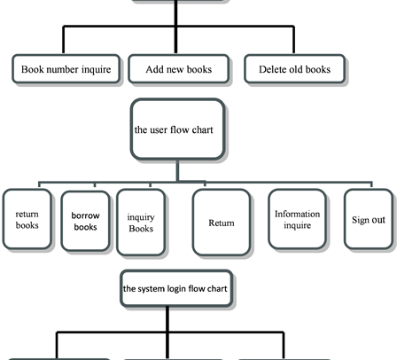
Proposed C++ Architecture
The proposed Digital Library & Paperless System offers a lightweight, high-performance console
application engineered with clean Object-Oriented Principles.
Role-Based Access: Distinct views for Students, Faculty, and System Administrators.
File Processing Engine: Saves catalog state and transactional logs continuously to disk.
Resource Indexer: Fast lookup using dynamic vectors and array search algorithms.

Slide 7



System Architecture & Modules
Module 1: User Mgmt Handles student/faculty accounts, user privileges, and active profile records.
Module 2: Classification
Auto-categorizes resources by domain,
media type, tags, and license type.
Module 3: Resource Engine Maintains eBook inventories ,file URLs, copies available, and access parameters.
Module 4: Access Control Processes checkouts, active download holds, issue limits, and return schedules.
Module 5: Archiving
Organizes course readers ,digital
archives, and paperless document repositories.
Module 6: Admin Reports Generates usage stats,system errorlogs, overdue reports, and summary metrics.

Slide 8

Module 1 - User Management
Account Creation: Register new students,
faculty members, and library staff with unique credentials.
Role Authentication: Enforces login validation for Admin privileges vs standard patron rights.
Member Profile Tracking: Stores current borrowed digital items, download limits, and fine history.

Slide 9




Module 2 - Smart Classification
Category Tagging
Classifies resources into
Computer Science, Engineering, Mathematics, Humanities, and General Science domains.
Format Indexing
Tracks media types
including PDF eBooks, EPUB readers, audio lectures, and interactive code notebooks.
Search Filtering
Implements fast string
comparison methods to filter by ISBN, author, keywords, or title substrings.

Slide 10


Module 3 - Digital Resource Engine
Resource Inventory Logic
Maintains dynamic records of all
available learning materials. Tracks current stock, allocated active licenses, digital file paths, and publisher metadata in real time.
CRUD Operations
Provides authorized
administrators with options to add newly acquired digital titles, update existing metadata, remove deprecated editions, and modify active license limits.

Slide 11
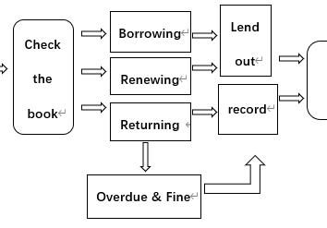
Module 4 - Borrowing & Access Control
Automated Digital Checkout: Users can request instant access keys or downloadable copies if licenses are within
safe thresholds.
Loan Duration Enforcement: Sets auto-expiring
checkout periods (e.g., 14 days for students, 30 days for faculty).
Fine Calculation Logic: Programmatically calculates overdue fines for delayed digital returns based on daily penalty rates.
Waitlist Prioritization: Queues checkout requests when maximum digital license limits are temporarily reached.

Slide 12
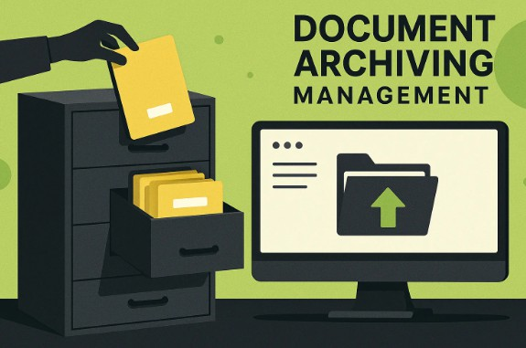
Module 5 - Archiving & Document Control
Paperless Repository Features
Course Reader Archiving: Bundles subject material,
syllabus PDFs, and historical exam papers per department. Disk Storage Compression: Efficient file record formatting in binary stream format (`fstream`).
Version Control: Maintains old textbook editions in secondary archive storage for historical research.

Slide 13
Module 6 - Admin Analytics & Metrics

Slide 14
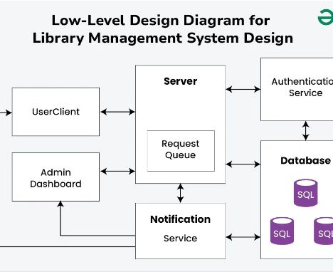
Use Case & System Interaction
Students: Search catalog, checkout eBooks, read course materials, view active due dates. Faculty: Recommend reading lists, reserve digital textbooks, request custom archives.
Librarian / Admin: Add/modify catalog inventory, manage member privileges, extract system logs.

Slide 15
System Workflow
Login & Auth
User logs in with
User ID and password validation.
OPAC Search
Query resources
by title, subject, or ISBN tag.
License Check
System verifies
active checkout availabilit y.
Checkout / Issue
Digital copy granted
& issue transaction logged.
Return & Report
Resource
returned or auto-expired; log updated.

Slide 16



C++ Programming Concepts Applied
OOP Principles
UtilizesClasses,Inheritan
ce, Encapsulation, and Polymorphism for clean separation of concerns.
File Handling
Uses`ifstream`and
`ofstream`stream objects for persistent
STL Containers
Applies`std::vector` and
standard algorithms for dynamic-memory
storage profiles lists.
of user and catalog
allocation and efficient data sorting.

Slide 17


System Advantages
100 % | 0 m s | 24 / 7 | 0 $
secure | Instant OPAC Search | Resource Accessibility | Third-party Software Cost
High Operational Speed: compilation ensures fast execution and low memory footprint.
Eco-Friendly & Sustainable: Reduces paper consumption across academic departments.
Modular Maintenance: Clean modular design allows seamless expansion of new features.

Slide 18
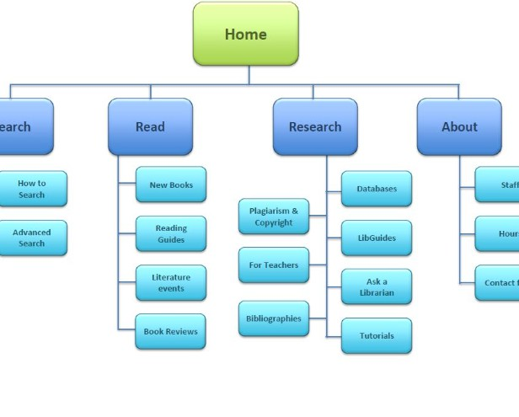
Future Enhancements
Cloud Storage Syncing: Integrate remote
S3/GCS buckets for unlimited asset distribution.
AI Semantic Search: Incorporate natural language processing for smart vector-based resource recommendations.
Cross-Platform Mobile App: Build
flutter/React Native frontends interacting with C□□ backend services.

Slide 19

Conclusion
The Digital Library & Paperless Learning Resource Management System demonstrates how foundational Object-Oriented paradigms and file processing techniques can effectively
automate academic resource administration, reduce paper waste, and deliver an intuitive learning platform.

Slide 20
Thank You!
Capstone Project |
Digital Library Management System

